Slide 1



Cameroon’s Music Export Barrier
Team HamoniX
Tayuh Favour

Slide 2




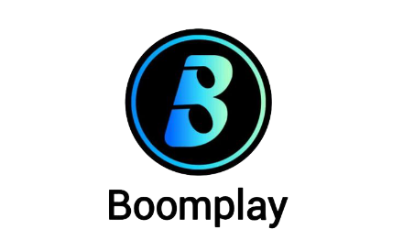




CAMEROON’S MUSIC EXPORT BARRIER
Talent is Equal. Access is Not.
Studio Production → $500
Distribution → $50/year
Press Kit → $300
Total → $850 Investment for Global Visibility
High Costs → No Producers → No Distribution → No Visibility

Slide 3





AI Export Pipeline Flow
Record
AI Beat
Press Kit
Package
Initial recording of the artist's music track.
Creation of unique beats using AI technology.
Generating promotional materials for the artist's release.
Finalizing and submitting to Spotify or Apple Music.

Slide 4

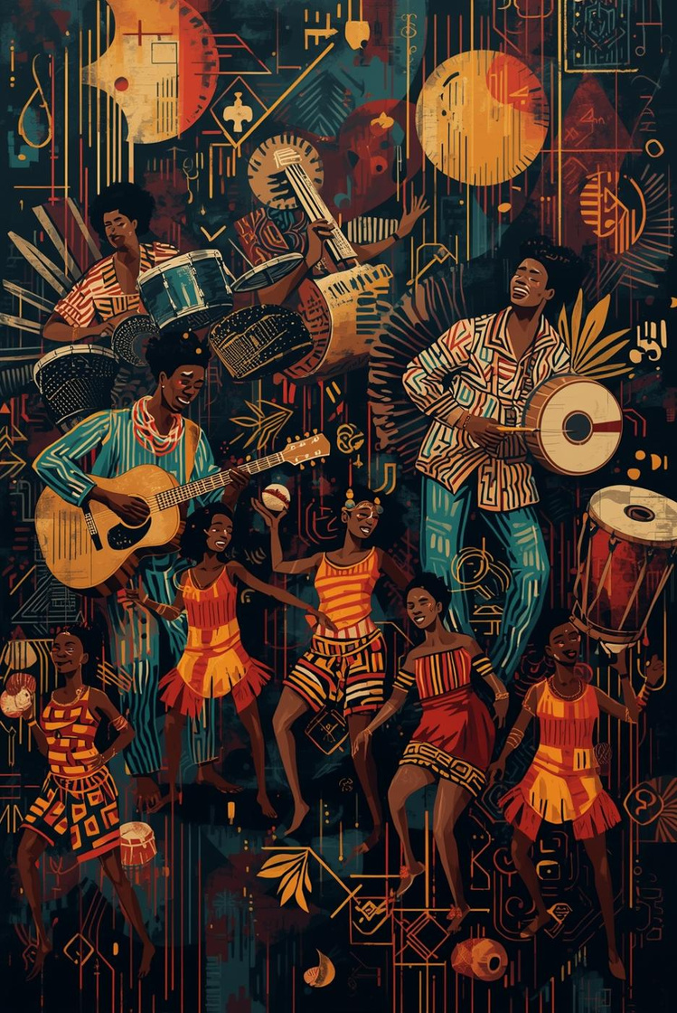
SOLVING THE CULTURAL TRANSLATION GAP
Generic AI Beat
Authentic Cameroonian Genres
Modern sound produced by algorithms and technology
Rich cultural rhythms rooted in tradition and heritage

Slide 5


MARKET CHALLENGE
Infrastructure and AI Access Limitations
The lack of supportive infrastructure and access to AI technology significantly hampers the growth of Cameroon’s music industry, limiting opportunities for artists to thrive and be discovered.

Slide 6

Business Model
Exploring Diverse Revenue Streams
Freemium Model
Premium Tiers
Pay-per-Export
Access Basic features
Boosts engagement
Users encouraged to upgrade
Subscription: $100/ month
HQ Exports
Unlimited projects
Priority Generation
No ads
Charges $80/ month
Flexible usage-based pricing
Access to valuable services

Slide 7
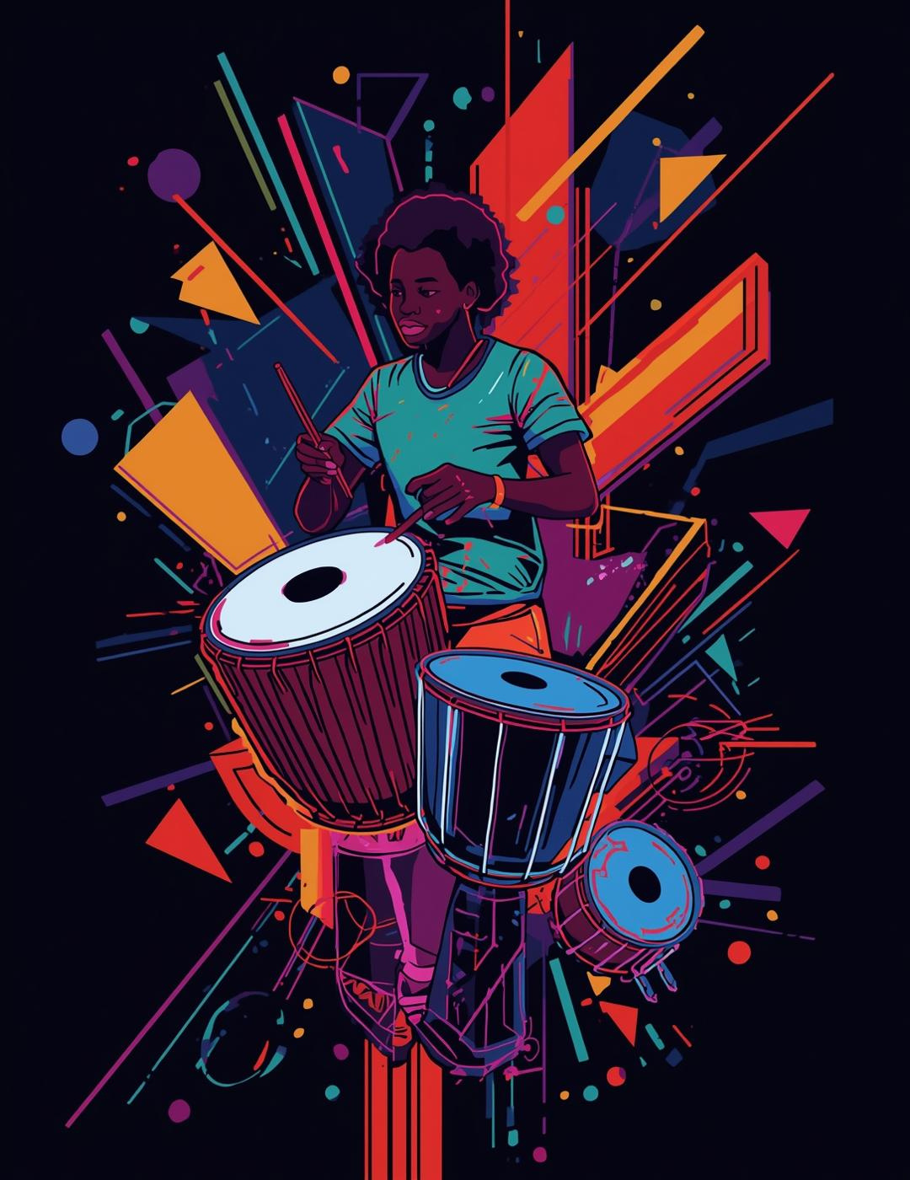

Connect With Us
Empower artists, share their talents
THANK YOU

Slide 8
MARKET ANALYSIS
Africa’s Exploding Music Market
African music growing 12% yearly
Afrobeats forecast: $15B by 2025
Streaming platforms aggressively expanding across Africa
Global creative industries prioritizing African content
Africa is rising and Cameroon must rise with it

Slide 9
MARKET ANALYSIS
CAMEROON: High Talent, Low Global Visibility
Cameroon’s underrepresentation
<3% African streaming contribution
<0.5% tracks on major afrobeats playlists
Cultural giants(Makossa, Bikutsi) missing from global DSPs
Why?
Production cost: $200-$500
Mastering cost: $50-$200
Press kit: $50-$200
Distribution: $20-$300/year
Total Export Barrier: $850+ per artist

Slide 10
MARKET ANALYSIS
Market Gap and User Segments
WHO WE SERVE
Artists: 120k+ emerging musicians
Creators: 1.5M+ TikTok/Instagram/Audiomack creators
Producers: 2k sound engineers
Diaspora fans: 5M+ global diaspora
No platform offers:
AI Beat Creation
AI Press Kit
AI Distribution
Cameroon Genre Intelligence

Slide 11

AI Benefits
AI technology is transforming the music export landscape, enabling artists to streamline their processes and significantly expand revenue streams through enhanced distribution and marketing strategies.

Slide 12
Connect With Us
Empower artists, share their talents
THANK YOU

